Slide 1
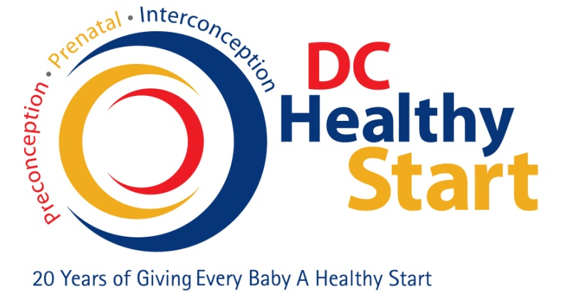

Healthy Start in the District of Columbia
Karen P. Watts, RNC, FAHM, PMP
Chief, Perinatal and Infant Health Bureau
DC Department of Health
Community Health Administration

Slide 2
What is DC Healthy Start?
A program to address significant disparities in perinatal health in the District.
Recruits pregnant women and postpartum women with infants up to 3 months of age
  DC residents
  Low-income
Assists women to improve birth outcomes through education and empowerment.

Slide 3
DC Healthy Start
Began 1991 in Wards 7 & 8
Expanded to Wards 5 & 6 in 1996

Slide 4
Why Are Services Available
Infant Mortality Rate (IMR) in District
  1991 IMR – 21 deaths/1000 live births
  2010 IMR – 8 deaths/1000 live births
Compared to White and Hispanic women, Black women have a higher rate of:
  Premature infants
  Low birth weight (<5 lbs. 8 oz.) and very low birth weights (<3 lbs. 5 oz.)
  Infant deaths

Slide 5
Infant Mortality in DC

Slide 6
DC Healthy Start Components
Outreach and Client Recruitment
Case Management
  Women
  Men
  Parents as Teachers curriculum
  Screenings (i.e. depression, substance abuse, domestic violence, infant developmental, etc.)
  Interconceptional Care
Health Education

Slide 7
Outreach and Client Recruitment
Community Involvement
  Sites (Residential and Community Based Organizations)
  Health Fairs
  Health Education and Training
  Community Canvassing
Screenings
Maternal Outreach Mobile

Slide 8
Maternal Outreach Mobile Van
Past

Slide 9
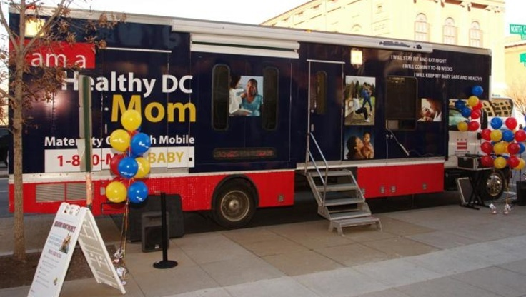
Maternal Outreach Mobile Van
Present

Slide 10
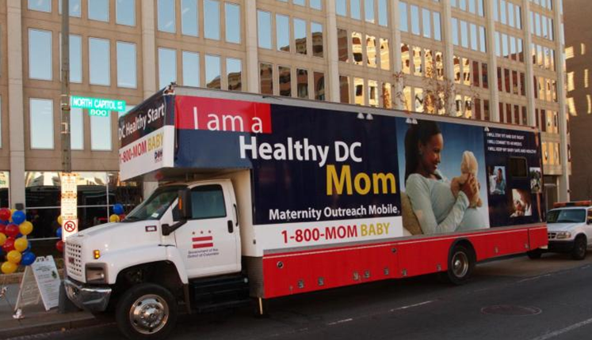
Maternal Outreach Mobile Van
Present

Slide 11
Case Management
Case Managers
  Nurses
  Family Support Workers
Home Visitation
Referral Management
Health Education and Training
  Parenting
  Breastfeeding

Slide 12
Male Outreach/Case Management
Health Fairs
Health Screening
Case Manage Men with children < 1 year
Job Skills Training Referral
Support to Obtain GED
Health Education
Referral Management

Slide 13
Health Education and Training
Stress Workshops
Parenting Classes
Sudden Infant Death Syndrome (SIDS) Classes
Fetal Alcohol Syndrome Classes
Smoking Cessation Classes

Slide 14
Conferences/Seminars
2009 – Building Healthier Communities Through the Power of Effective Networking
2010 – Fetal Alcohol Spectrum Disorder
2011 – From Here to Paternity
2011 – Refining Service Delivery in the Community
26 Sep 12 – Reducing the Stigma of Mental Health
10 Dec 12 – Understanding the DC Roadmap of Newborn Hearing Screening
Save the Date

Slide 15

DC Healthy Start
Working to improve birth outcomes in the District!
Questions???

