Slide 1
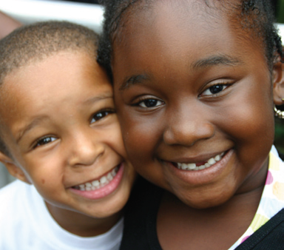
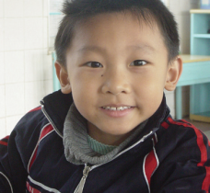
District of Columbia Immunization Requirements¹
School Year 2015 – 2016
All students attending school in the District of Columbia must present
proof of appropriately spaced immunizations by the first day of school.
4 Diphtheria/Tetanus/Pertussis (DTaP)
3 Polio
1 Varicella (chickenpox) – if no history of disease²
1 Measles, Mumps & Rubella (MMR)
3 Hepatitis B
2 Hepatitis A
3 or 4 Hib (Haemophilus Influenza Type B) ³
4 PCV (Pneumococcal)
A Child 2 years or older entering
Preschool or Head Start
5 Diphtheria/Tetanus/Pertussis (DTaP)
4 Polio
2 Varicella (chickenpox) – if no history of disease²
2 Measles, Mumps & Rubella (MMR)
3 Hepatitis B
2 Hepatitis A
3 or 4 Hib (Haemophilus Influenza Type B) ³
4 PCV (Pneumococcal)
A student 4 years old entering
Pre-Kindergarten
5 Diphtheria/Tetanus/Pertussis (DTaP)
4 Polio
2 Varicella (chickenpox) – if no history of disease²
2 Measles, Mumps & Rubella (MMR)
3 Hepatitis B
2 Hepatitis A (if born on or after 01/01/05)
A student 5 – 10 years old entering
Kindergarten thru Fifth Grade
5 Diphtheria/Tetanus/Pertussis (DTaP/Td)
1 Tdap
4 Polio
2 Varicella (chickenpox) – if no history of disease²
2 Measles, Mumps & Rubella (MMR)
3 Hepatitis B
1 Meningococcal
3 Human Papillomavirus Vaccine (HPV) – Students in grades 6
thru 12 or parent may sign approved vaccine refusal form
available at www.doh.dc.gov
A student 11 years & older entering
Sixth thru Twelfth Grade
¹ At all ages and grades, the number of doses required varies by a child’s age and how long ago they were vaccinated. Please check with your
child’s school nurse or health care provider for details.
² All Varicella/chickenpox disease histories MUST be verified/diagnosed by a health care provider (MD, NP, PA, RN) and documentation MUST
include the month and year of disease.
³ The number of doses is determined by brand used.
Rev 01-15

Slide 2
District of Columbia Immunization Requirements¹
School Year 2015 – 2016
All students attending school in the District of Columbia must present
proof of appropriately spaced immunizations by the first day of school.
4 Diphtheria/Tetanus/Pertussis (DTaP)
3 Polio
1 Varicella (chickenpox) – if no history of disease²
1 Measles, Mumps & Rubella (MMR)
3 Hepatitis B
2 Hepatitis A
3 or 4 Hib (Haemophilus Influenza Type B) ³
4 PCV (Pneumococcal)
A Child 2 years or older entering
Preschool or Head Start
5 Diphtheria/Tetanus/Pertussis (DTaP)
4 Polio
2 Varicella (chickenpox) – if no history of disease²
2 Measles, Mumps & Rubella (MMR)
3 Hepatitis B
2 Hepatitis A
3 or 4 Hib (Haemophilus Influenza Type B) ³
4 PCV (Pneumococcal)
A student 4 years old entering
Pre-Kindergarten
5 Diphtheria/Tetanus/Pertussis (DTaP)
4 Polio
2 Varicella (chickenpox) – if no history of disease²
2 Measles, Mumps & Rubella (MMR)
3 Hepatitis B
2 Hepatitis A (if born on or after 01/01/05)
A student 5 – 10 years old entering
Kindergarten thru Fifth Grade
5 Diphtheria/Tetanus/Pertussis (DTaP/Td)
1 Tdap
4 Polio
2 Varicella (chickenpox) – if no history of disease²
2 Measles, Mumps & Rubella (MMR)
3 Hepatitis B
1 Meningococcal
3 Human Papillomavirus Vaccine (HPV) –Students in grades 6
thru 12 or parent may sign approved vaccine refusal form
available at www.doh.dc.gov
A student 11 years & older entering
Sixth thru Twelfth Grade
¹ At all ages and grades, the number of doses required varies by a child’s age and how long ago they were vaccinated. Please check with your
child’s school nurse or health care provider for details.
² All Varicella/chickenpox disease histories MUST be verified/diagnosed by a health care provider (MD, NP, PA, RN) and documentation MUST
include the month and year of disease.
³ The number of doses is determined by brand used.
Rev 01-15

